Slide 1
Machine Learning Models for the Diagnosis of Parkinson Using Audio Signals
Healthcare Digital Ecosystems: Hypotheses, Methods and Applications
1st jRoMedINF Conference – May 13-14, 2024
AUTHORS:
DENISA-GABRIELA MUSTEAȚĂ
LAVINIA-EUGENIA FERARIU
Department of Automatic Control and Applied Informatics
Gheorghe Asachi Technical University of Iasi, Romania

Slide 2
Table of Contents
Introduction
Diagnosis Using Fourier Features and Random Forest
Diagnosis Using CNN AlexNet Model and Mel-Spectrograms
Optimization Using Genetic Algorithms
Conclusions

Slide 3
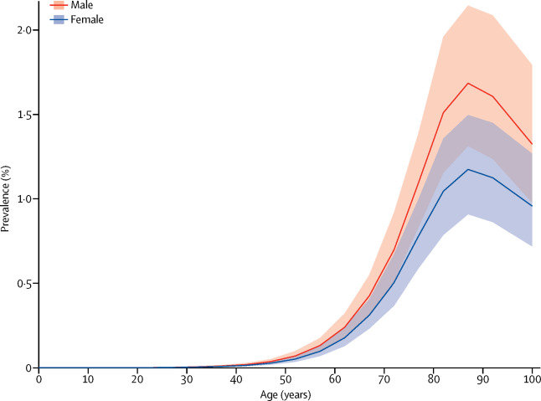
Introduction
Parkinson's disease - the second most common after Alzheimer's among the global population.
It affects:
Prosody
Articulation
Phonetics
More common among men
(for ages ≥ 50)
Main Objective:
Raw signals
Processing
Process Optimization
Train, Test, Validation
Better Results (over 90% for test and validation)

Slide 4
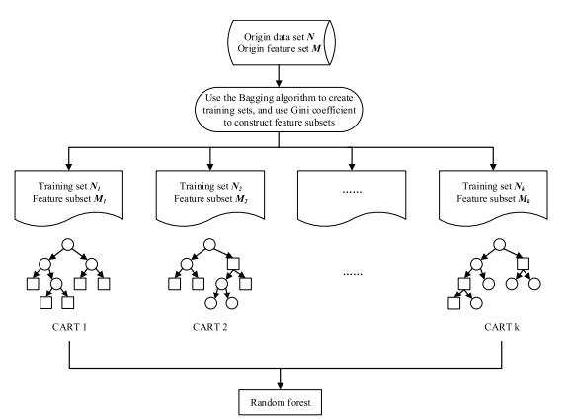
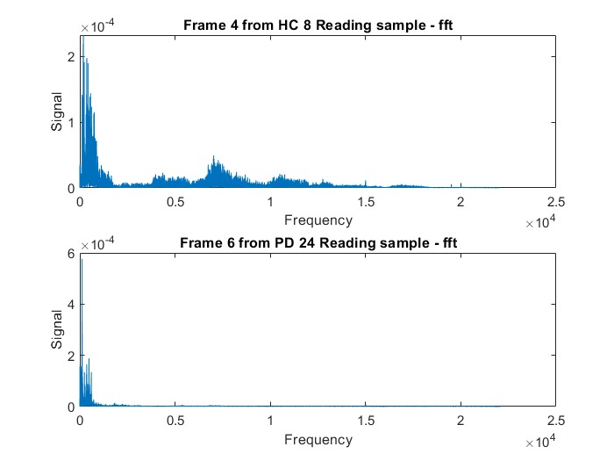
Diagnosis Using Fourier Features and Random Forest
Preprocessing
Windowing and Filtering
Getting the features
Fourier Transform
Random Forest Architecture

Slide 5
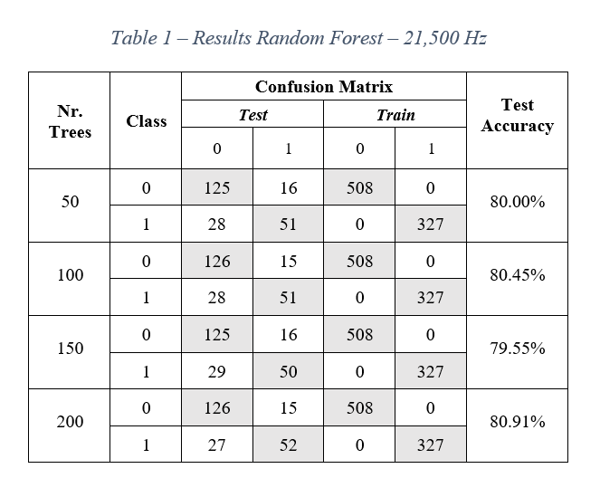
Diagnosis Using Fourier Features and Random Forest
100% Acuracy on Training
Process:
Labels Vector
Partitioning
Training
Results analysis
Features Extraction
Data Analysis
Important step
Frequency Range
80% - Train
20% - Test
Average Accuracy:
1,500 Hz – 79.88%
11,500 Hz – 77.55%
21,500 Hz – 80.22%
Best result for
accuracy

Slide 6
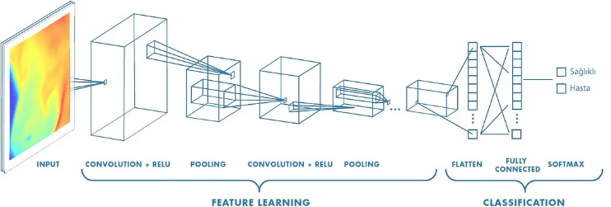
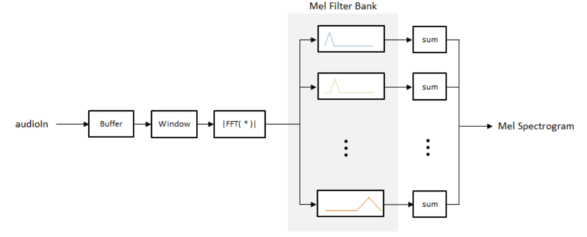
Diagnosis Using CNN Model AlexNet and Mel-Spectrograms
Architecture of the AlexNet model that processes spectrograms
Mel-spectrograms construction
?
Why
Mel-spectrograms and not classic spectrograms?

Slide 7
Achieved results for CNN Model AlexNet
Nr. Crt. | Window Size | Num Bands | AlexNet Training Results
 |  |  | Train | Test | Validation
1. | 256 | 16 | 88.64% | 81.82% | 76.36%
2. | 256 | 32 | 96.14% | 85.45% | 81.82%
3. | 256 | 64 | 95.34% | 80.91% | 83.64%
4. | 512 | 16 | 92.05% | 79.09% | 81.82%
5. | 512 | 32 | 97.05% | 84.55% | 83.64%
6. | 512 | 64 | 94.32% | 80.91% | 78.18%
7. | 1024 | 16 | 92.39% | 89.09% | 76.36%
8. | 1024 | 32 | 95.00% | 81.82% | 86.36%
9. | 1024 | 64 | 94.43% | 78.18% | 78.18%
10. | 2048 | 16 | 90.23% | 78.18% | 81.91%
11. | 2048 | 32 | 94.32% | 81.82% | 79.09%
12. | 2048 | 64 | 94.32% | 85.45% | 82.73%
13. | 4096 | 16 | 86.48% | 76.36% | 74.55%
14. | 4096 | 32 | 88.52% | 72.73% | 77.27%
15. | 4096 | 64 | 89.43% | 77.27% | 78.18%
Best results obtained for test and validation dataset (over 80% accuracy):
Window Size = 256, NumBands = 32
Window Size = 512, NumBands = 32
Window Size = 1024, NumBands = 32
Window Size = 2048, NumBands = 64
Next Step:
Optimization for choosing
the best combination for
these two parameters
Better results than in the case of random forest

Slide 8
Optimization Using Genetic Algorithms
New Generation
New Solutions
For each solution it creates Mel-spectrograms
Train the new set with AlexNet
Calculate the Accuracy
a pair of two
random numbers
Objective function:
2 exponents ([e1,e2])for
Window Length: 2^e1
Number of Mel Bands: 2^e2
Encoding: binary
Genetic operators:
discrete crossover
uniform mutation
Genetic
Algorithm
Structure
with different but
smaller numbers
for epochs and
dimension of MBS

Slide 9
Achieved results for CNN Model AlexNet Optimized by the Genetic Algorithms
Nr. Crt. | AlexNet Training Results With GA |  |  |  |  | MBS | NEP | AlexNet Training Results
 |  |  |  |  |  |  |  | Train | Test | Validation
 | NEP GA | MBS GA | Nr. Indiv. | ObjV | Phen [e1, e2]
1. | 50 | 25 | 4 | 0.1364 | [9,7] | 100 | 50 | 97.05% | 80.91% | 88.18%
2. | 50 | 25 | 4 | 0.1364 | [9,7] | 50 | 100 | 99.77% | 87.27% | 81.82%
3. | 100 | 50 | 4 | 0.0375 | [10,4] | 100 | 50 | 93.52% | 80.91% | 90.00%
4. | 100 | 50 | 4 | 0.0375 | [10,4] | 50 | 100 | 99.20% | 84.55% | 85.45%
5. | 150 | 75 | 4 | 0.0364 | [9,5] | 100 | 50 | 96.93% | 83.64% | 84.55%
6. | 150 | 75 | 4 | 0.0364 | [9,5] | 50 | 100 | 99.43% | 80.00% | 85.55%
7. | 50 | 25 | 8 | 0.0432 | [7,5] | 100 | 50 | 96.36% | 83.64% | 80.00%
8. | 50 | 25 | 8 | 0.0432 | [7,5] | 50 | 100 | 99.66% | 90.00% | 89.09%
9. | 25 | 50 | 8 | 0.1284 | [8,7] | 100 | 50 | 94.77% | 88.18% | 81.82%
10. | 25 | 50 | 8 | 0.1284 | [8,7] | 50 | 100 | 98.64% | 87.27% | 83.64%
Main Benefits:
Better results than in the case when
parameters are manually selected
No results under 80%
Almost 100% accuracy for training
Accuracy for test and validation – 90%

Slide 10
Conclusions
Diagnosis of Parkinson’s disease using audio signals
- with Random Forest using Fourier Features
- with AlexNet using Mel-spectrograms
- with GA for optimizing the Mel-spectrograms
Good results with all methods
Best accuracy: with AlexNet for Mel-spectrograms optimized by
Genetic Algorithm
Future improvements: optimization of other
parameters through the genetical method

